Slide 1
Detecting Polyps From Colonoscopy images
Presentation by:
Kethamakka.Karthikeya

Slide 2
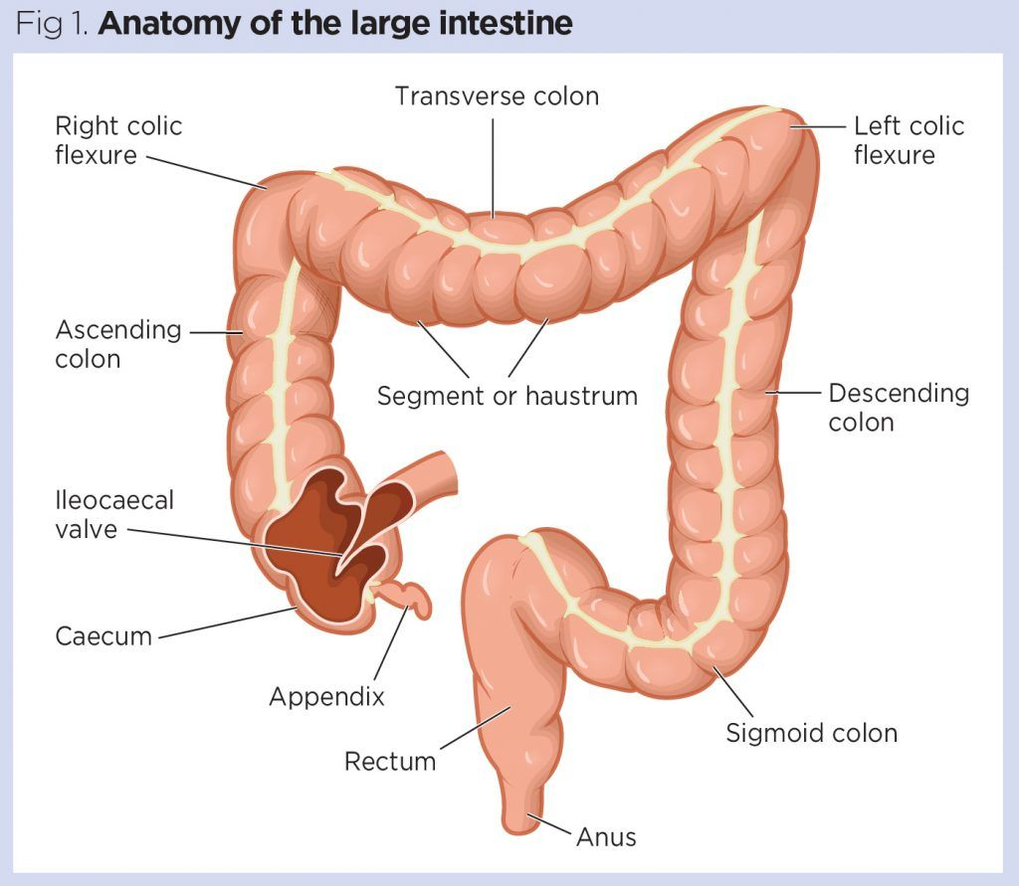
Anatomy of Colon

Slide 3
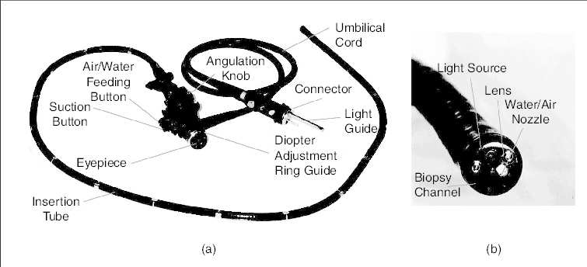
Colonoscope

Slide 4
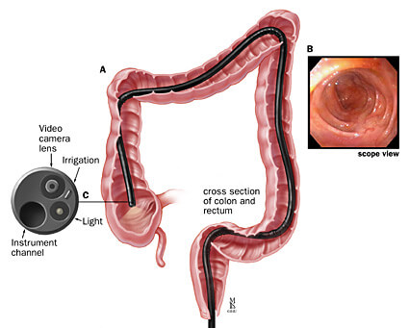
Colonoscopy Procedure
The Colonoscope is inserted through rectum.
It takes around 30 minutes to complete colonoscopy.
The video camera provides a live feed.
The doctor inspects the feed for any abnormalities.

Slide 5
Colon Cancer Information
Polyps develop into cancer.
Mostly type-2 and type-3 develop into cancer
It is the third most common cancer also third leading cause of cancer related deaths.
Easiest way to prevent colon cancer is to get Colonoscopy.

Slide 6
Adenoma Detection rate-ADR
An adenoma detection rate (ADR) is defined as the proportion of patients aged ≥50 years undergoing screening colonoscopy in which ≥1 adenomatous polyp is found.
The efficient way to improve ADR is to have Proper Bowel Prep, In addition to this we could make use of Machine Learning to segment and classify the live colonoscopy feed to detect polyps.
The doctors also use imaging techniques to analyze feeds in an efficient manner.
To improve the ADR, it is also important that the patient undergoes strict bowel prep, However we shall concentrate on ML part here.

Slide 7
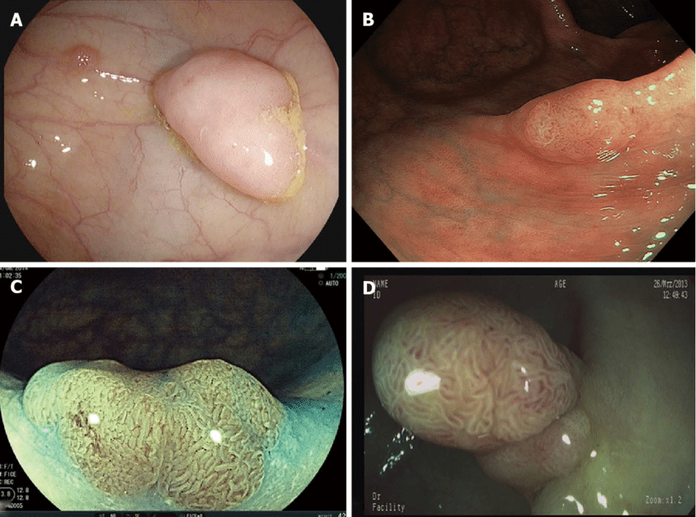
Various Imaging techniques used to examine feed
A-Narrow Band Imaging
B-Fujinon Intelligent Color Enhancement
C-Iscan
D-Dye Less chromoendoscopy

Slide 8
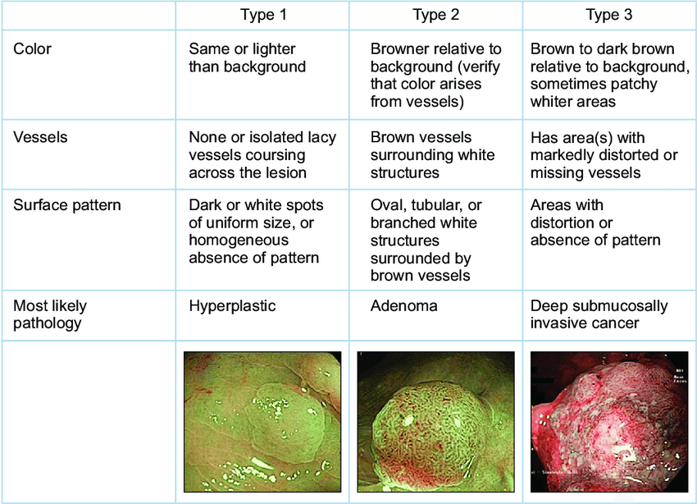
Different Types of Polyps

Slide 9
Project-Overview
We performed image segmentation on Colonoscopy data.
We performed Localized image segmentation and super pixel algorithms.
We performed two deep learning approaches Unet, Unet with VGG-19.
We performed supervised machine learning in case of deep learning.

Slide 10
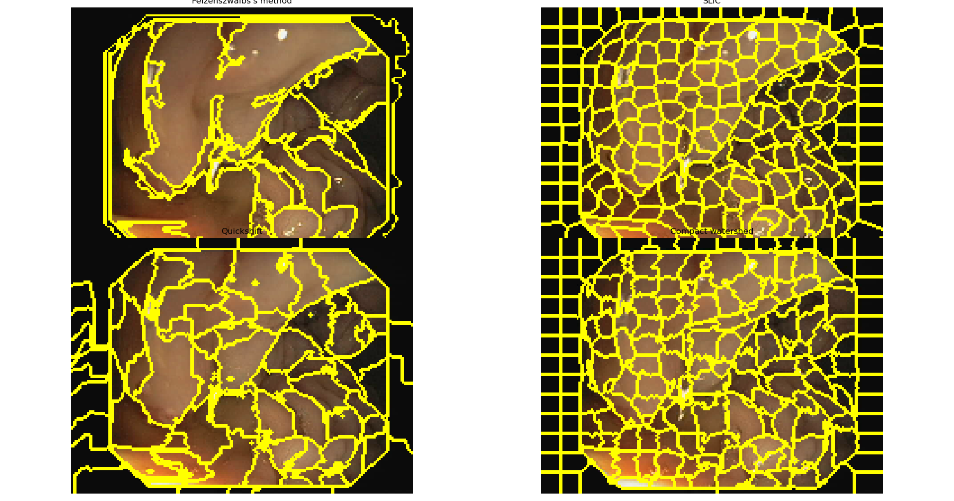
Localized approach
1- Felzenszwalb’s efficient graph-based segmentation
2- Quickshift image segmentation
3- SLIC - K-Means based image segmentation
4- Compact watershed segmentation of gradient images
It is to be noted that neither of these approaches can be used for intelligent detection, However they can be used by doctors in conjunction with the imaging they use to analyze the feed on the go, as they are simple to implement.

Slide 11
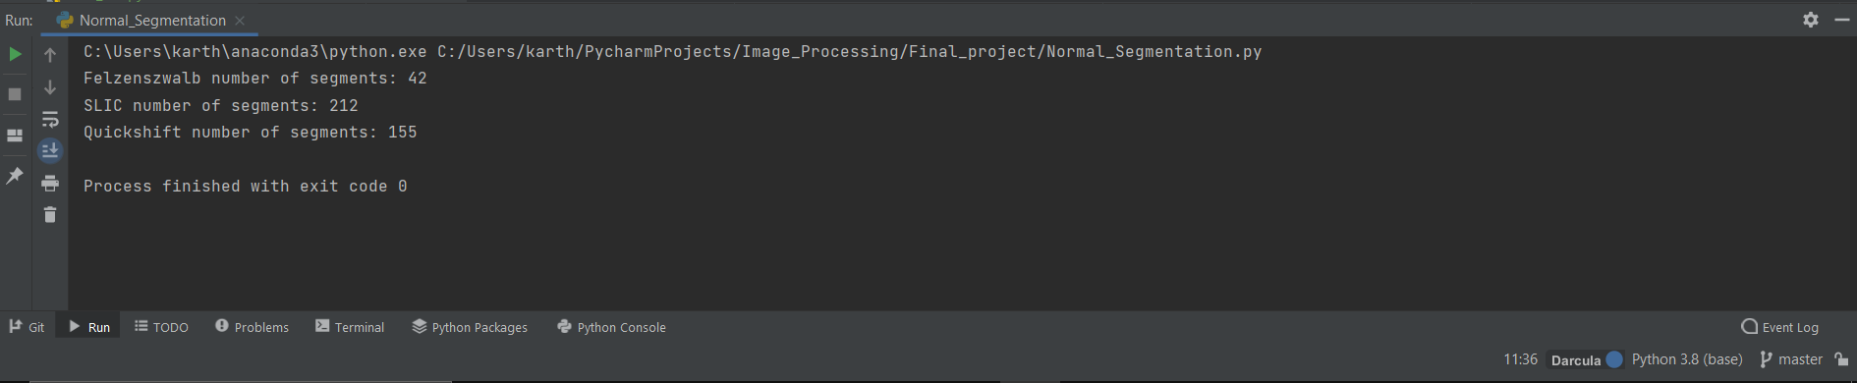
Localized approaches summary
In this case we could use Quick shift rather than other approaches since it detects way more segments which can aid doctors in identifying small polyps.

Slide 12
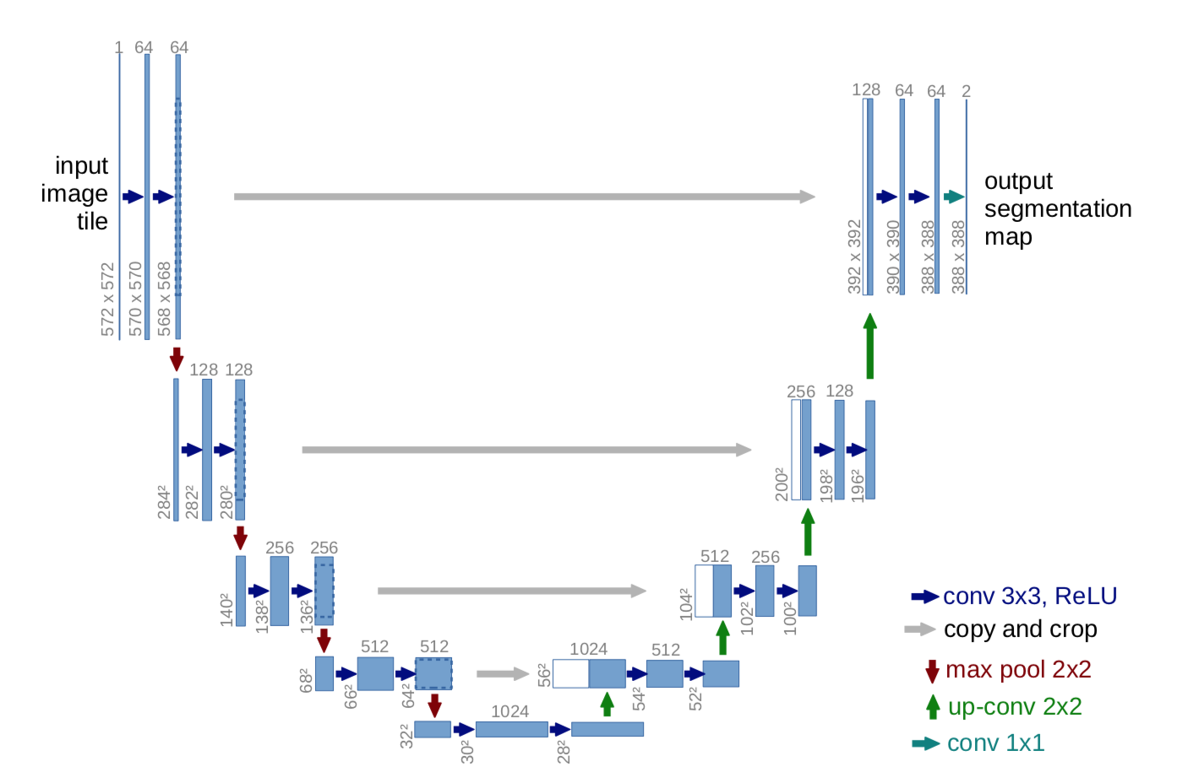
U-Net Approach
It detects image features on pixel level.
It has two encoder paths followed by ReLU this part captures context
Then we have expansion part on the right side
U-Net has been a revolutionary approach has contributed for significant growth in image segmentation in medical imaging application.
Due it its focus on pixel by pixel approach it is also able to detect small features

Slide 13
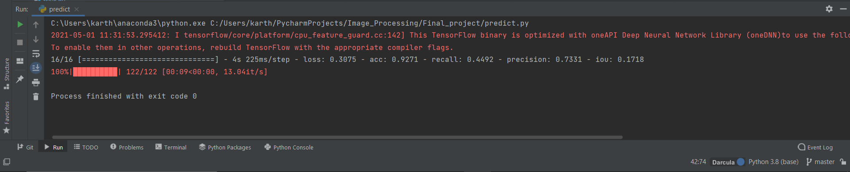
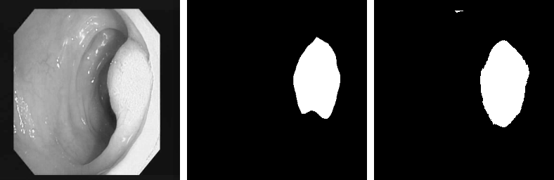
U-Net Sample Output and Statistics

Slide 14
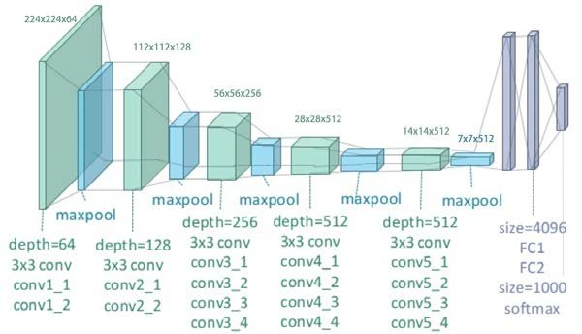
U-Net with VGG-19
VGG-19 is huge deep learning model with 19 layers.
It can be used in conjunction with various existing approaches to improve model performance.
It is fully Convoluted Neural network with 19 layers.
It is known to be difficult to train both in terms of computation power and time.
We used it in conjunction with U-Net to improve accuracy.

Slide 15
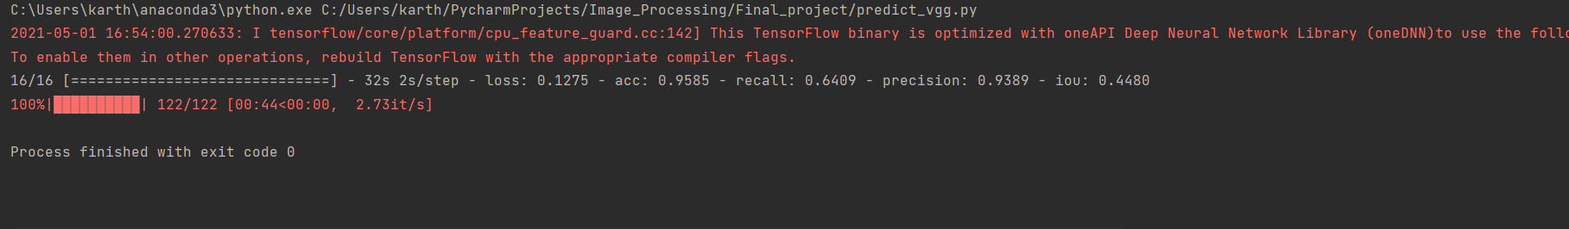
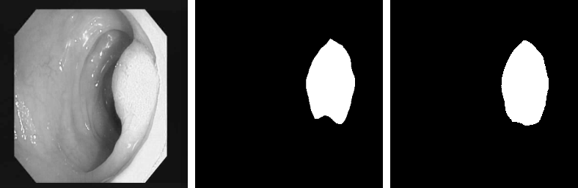
U-Net with VGG-19 sample output and Statistics

Slide 16
Technology Transfer
We could directly implement localized approaches to analyze feed in a better way.
We could use segmentation along with classification and pretrain the model beforehand and implement it on massive dataset and use it to predict on live feed.

Slide 17
Challenges
Accuracy could have been improved by increasing training data size and fine-tuning model.
The project in its shape cannot be used in industry it requires classification part attached to improve prediction accuracy and aid doctors.
We could use better machines to handle the training load of massive datasets.

Slide 18
References
http://training.seer.cancer.gov/
https://www.hopkinsmedicine.org/gastroenterology_hepatology/clinical_services/basic_endoscopy/colonoscopy.html
https://www.nursingtimes.net/clinical-archive/gastroenterology/gastrointestinal-tract-5-anatomy-functions-large-intestine-23-09-2019/
https://www.researchgate.net/figure/The-a-conventional-colonoscope-and-b-its-distal-end-view-displaying-the-arrangement_fig1_3246225
https://www.researchgate.net/figure/Colonic-polyp-imaged-with-high-definition-white-light-A-narrow-band-imaging-B_fig1_273781494
https://scikit-image.org/docs/dev/auto_examples/segmentation/plot_segmentations.html
https://www.cancer.org/cancer/colon-rectal-cancer/about/key-statistics.html
https://towardsdatascience.com/unet-line-by-line-explanation-9b191c76baf5
https://www.google.com/search?q=VGG-19&sxsrf=ALeKk03FO59UjJ2XBdUtkLN0GIEpE5X77Q:1619990654046&source=lnms&tbm=isch&sa=X&ved=2ahUKEwjpw-S796vwAhUEJTQIHfUFByMQ_AUoAXoECAEQAw&biw=1536&bih=792&dpr=1.25#imgrc=gWpOWCUibA2HHM
Comparison of segmentation and superpixel algorithms — skimage v0.19.0.dev0 docs (scikit-image.org)
CVC-ClinicDB.rar (dropbox.com)

